Slide 1
AI in Medicine
Assignment 4: MIMIC NLP
Gabriel Figueiredo Miller

Slide 2
Foreward
Name entity recognition (NER) as well as NLP methods were used on filtered notes from the MIMIC III dataset based on a single disease: Pneumonia to help understand the ability of these methods for identifying and categorizing key information in text.
Several NER approaches were utilized, leveraging the strengths of different libraries:
spaCy: Provides a foundational framework for general NLP tasks.
SciSpaCy: Enhances spaCy's capabilities with additional scientific and biomedical text processing functionalities.
MedSpaCy: Further specializes in medical text offering optimized entity recognition and linking to medical ontologies.
After applying NER and building a corpus for each of the three modules/models, word2vec was used to obtain vector representations of the corpus; i.e., word embeddings.
Results were visualized using tSNE to reduce the dimensionality of the word embeddings to two dimensions for viewing purposes.
Additionally, k-means clustering was leveraged to help visualize the similar concepts obtained based on proximity within a given cluster.

Slide 3
Configuration
Code was created and run in a jupyter notebook that was created using AWS cloud, specifically using a SageMaker notebook instance.
The notebook was stood up on an ml.m5.2xlarge EC2 server instance with Amazon Linux 2 and Jupyter Lab 3 installed and an EBS volume size of 40GB.
Data was stored and then downloaded from AWS S3 into Jupyter Home.
A conda environment was created with Python 3.8 installed.
spaCy, SciSpaCy and MedSpaCy were all installed, as well as boto3, pandas, numpy, matplotlib, and gensim.

Slide 4
Implementation

Slide 5
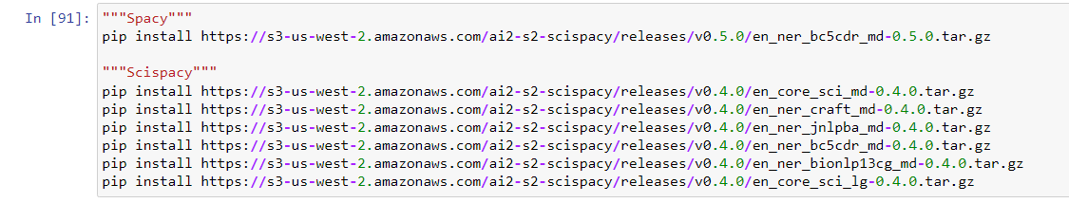
Download models
Pip install specific models related to both spaCy and sciSpaCy for name entity recognition (NER).

Slide 6
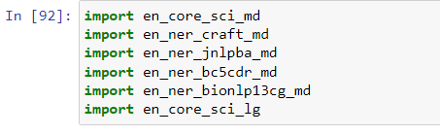
Import SciSpaCy models
Importing different sciSpaCy models.
en_core_sci_md: This is a general-purpose model for processing scientific text in English. It is a medium-sized model trained on a broad range of scientific texts and is good for basic NLP tasks like tokenization, part-of-speech tagging, and dependency parsing in a scientific context.
`en_ner_craft_md`: Trained on the CRAFT corpus, this model identifies entities like genes, proteins, chemicals, and diseases.
`en_ner_jnlpba_md`: Trained on the JNLPBA corpus, this model also focuses on biomedical entities.
`en_ner_bc5cdr_md`: Trained on the BioCreative V CDR corpus, this model is particularly good at recognizing chemical and disease entities.
`en_ner_bionlp13cg_md`: Trained on the BioNLP 2013 CG corpus, this model is designed to identify entities related to cancer genetics.
`en_core_sci_lg`: This is a larger version of the general scientific model (`en_core_sci_md`). It has a larger vocabulary and can potentially provide more accurate results, but it also requires more memory and processing power.

Slide 7
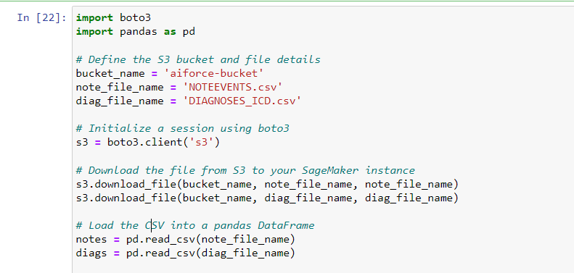
Download data
Downloading data from s3 bucket into notebook instance and loading into JNB using pandas.

Slide 8
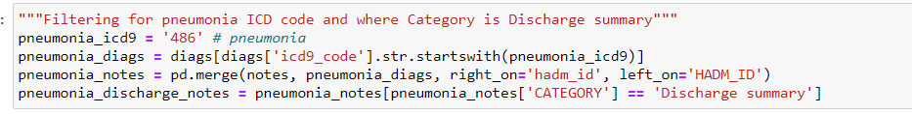
Filtering data
Extracted diagnosis entries with an ICD-9 code starting with '486' (pneumonia) from the diags dataframe.
Merging data: Merged the filtered pneumonia diagnosis with patient notes based on the hospital admission ID (hadm_id), combining the diagnosis information with associated notes.
Selecting discharge summaries: Filtered the merged dataset to retain only those notes where the category is 'Discharge summary', narrowing the focus to relevant patient discharge documentation.

Slide 9
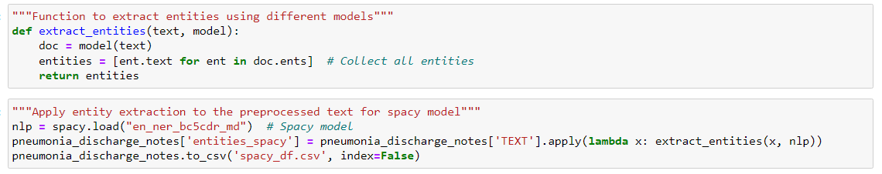
Entity extraction: spaCy
Function, ‘extract_entities()’ applies general NER model to text (e.g., patient clinical notes).
Returns entities related to text input.
Applied here to pneumonia discharge notes for each patient using spaCy model, ‘en_ner_bc5cdr_md’
Data saved in order to expedite future processing steps; i.e., don’t have to re-run the NER again.

Slide 10
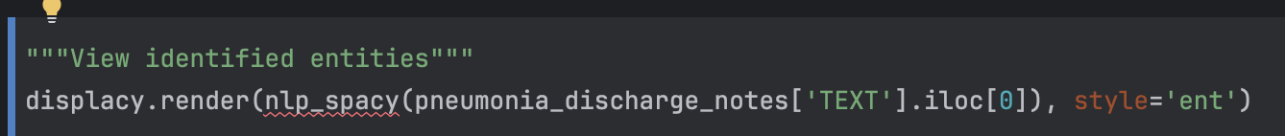
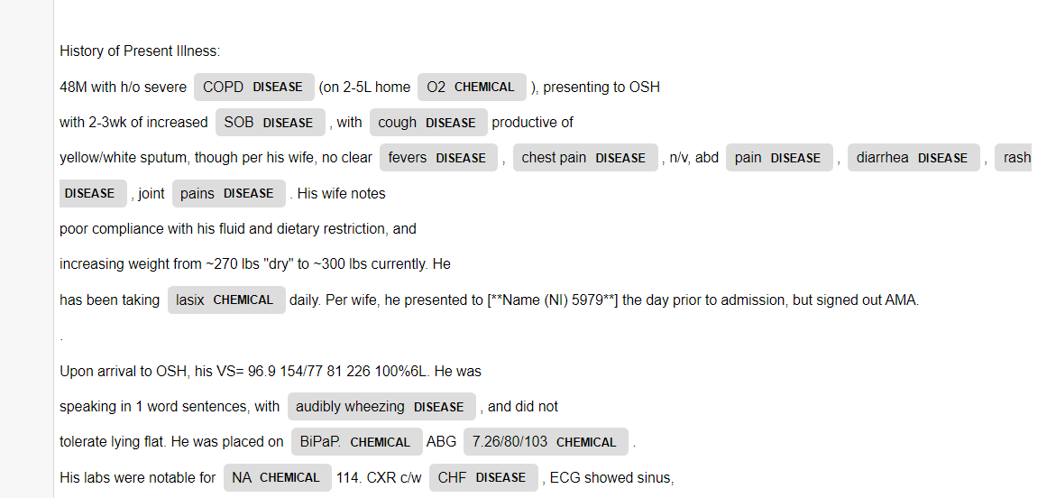
NER results: spaCy
Visualize NER results using spaCy module, displacy.
Displacy enables NER visualization
Arg, ‘ent’ style generates display of specific entities identified in the text with respect to dictionary of categorical identities spaCy model is trained to recognize.
Recognized entities are quite general, e.g., DISEASE, CHEMICAL

Slide 11
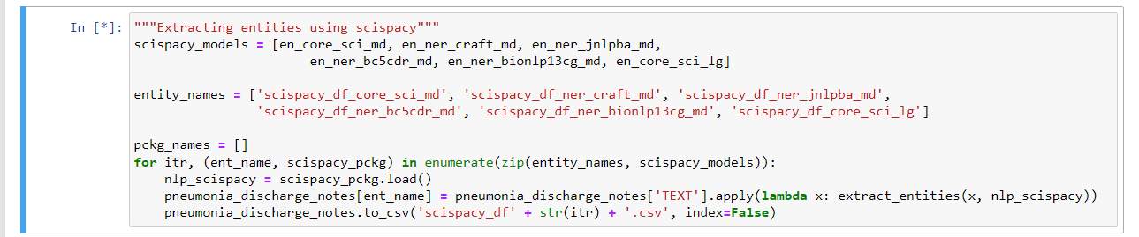
Entity extraction: SciSpaCy
Extracting results for several SciSpacy models
Data saved in order to expedite future processing steps; i.e., don’t have to re-run the NER again.

Slide 12
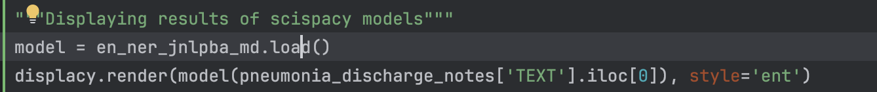
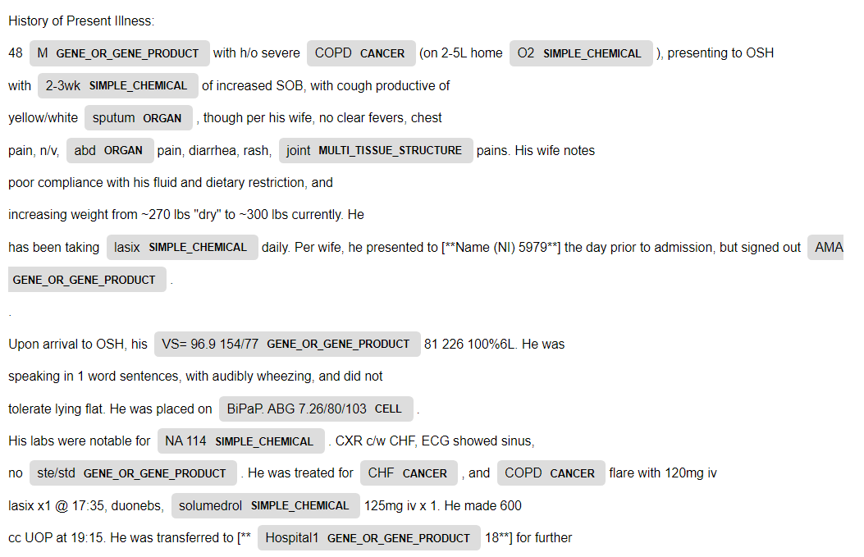
NER results: SciSpaCy (model: jnlpba_md)
Visualize NER results using spaCy module, displacy.
Model of interest chosen for visualization, jnlpba_md, focuses on biomedical entities.
Can recognize more specific medically-related entities relative to spaCy, e.g., ORGAN, CANCER, MULTI_TISSUE_STRUCTURE, GENE_OR_GENE_PRODUCT.

Slide 13
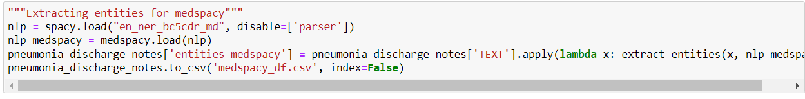
Entity extraction: MedSpaCy
Utilize MedSpaCy loader to augment the standard spaCy model to enhance detection of medically-specific terms.
Disable the grammatical parser of the spaCy model to enable the integration of MedSpaCy.

Slide 14
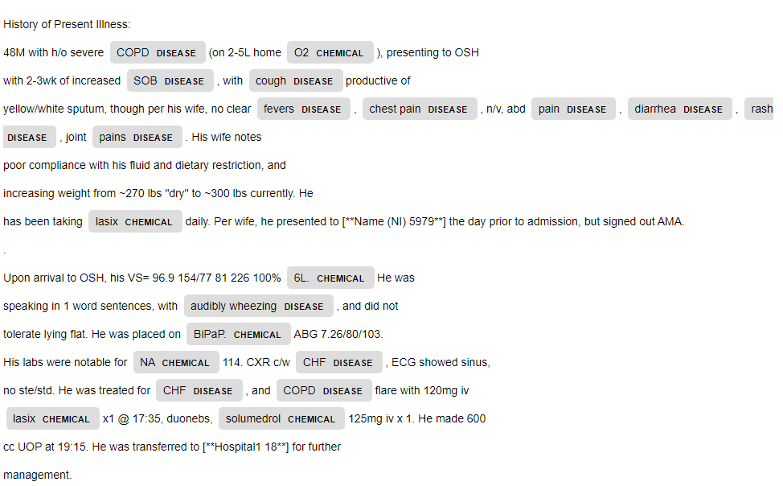
NER results: MedSpaCy
Visualize NER results using spaCy module, displacy.
medSpaCy extends spaCy for clinical text providing specialized tools and components.
In this scenario, medSpaCy uses spaCy’s base functionality and is capable of including specific medical entity recognition models to detect entities and categories relevant to clinical settings.

Slide 15
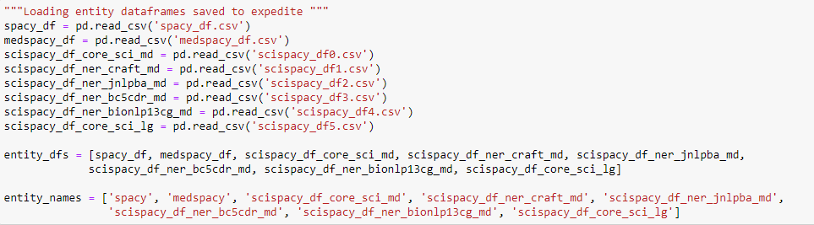
Loading entity data and prepping for further analysis

Slide 16
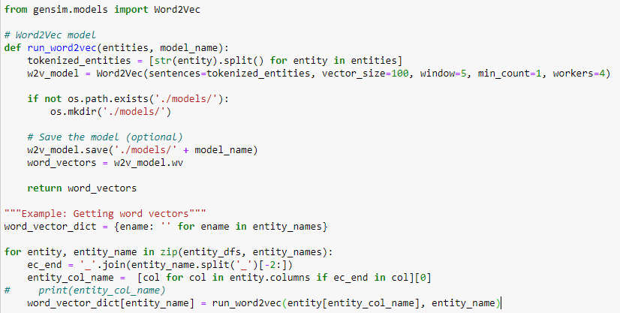
Applying Word2Vec
Word2Vec applied to previously determined entities for all models.
Word2Vec embeddings are widely used in various NLP tasks due to their ability to capture the meaning and relationships between words.
The process captures semantic similarity, meaning words with similar meanings have vectors that are close together in the vector space
Model has hyper-parameters; those used include: vector_size (dimensionality of the word embeddings), window (context window size), min_count (minimum frequency threshold for word to be excluded) and workers (number of CPU threads)

Slide 17
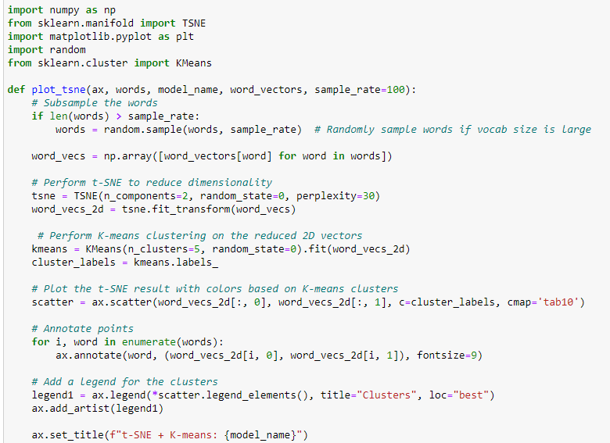
Visualize word embeddings: t-SNE + K-means clustering
t-SNE and k-means clustering used to help visualize word embeddings.
t-SNE is a technique for reducing high-dimensional data into 2D or 3D for visualization while preserving local structures.
The perplexity parameter balances the focus between local and global relationships influencing the clustering in reduced space.
K-means groups data into k clusters by minimizing the distance between points and centroids,
Number of clusters (n_clusters) is a hyper-parameter that must be pre-selected (used n_clusters=5)

Slide 18
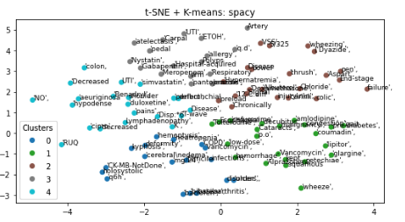
t-SNE + K-means clustering: spaCy
Each point represents a word, and the corresponding text is labeled.
Cluster examples below:
Cluster 0 includes terms related to medical conditions and treatments. Words like "colon," "duloxetine," and "diabetes" suggest a focus on diseases and associated medications or conditions.
Cluster 2: terms related to symptoms and physical examination.
Cluster 3: terms specific to medications and pharmacology. This includes "Vancomycin," "diluted," and "medication"

Slide 19
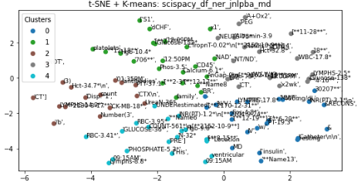
t-SNE + K-means clustering: SciSpaCy (jnlpba)
Jnlpba has focus on terms related to biomedicine. Examples below
Cluster 0 focuses on lab measurements and medical tests with terms like Glucose, Phosphate-5 and insulin
Cluster 2 focuses on vital signs and physical health measurements with key terms such as "BP-120/80," "HR-106," "O2."
Cluster 3 focuses on imaging and diagnostic terms: "CT," "X-ray," "AD.

Slide 20
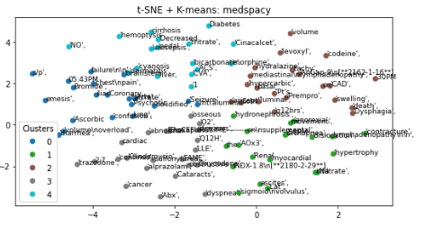
t-SNE + K-means clustering: MedSpaCy
Each point represents a word, and the corresponding text is labeled.
Cluster examples below:
Cluster 0 focuses on medical terms, treatments, and medications, e.g., "diabetes," "codeine," "Cinacalcet," "uremia."
Cluster 2 focuses on diagnostic terms, e.g., "CAD," "hyperplasia," "cirrhosis."
Cluster 3 focuses pharmacological agents and measurements with key terms, "promethazine," "NaCl," "furosemide."

Slide 21
Summary
SpaCy, scispaCy, and medspacy are NLP libraries for extracting named entities, with spaCy for general text, scispaCy for biomedical texts, and medspacy for clinical notes.
ScispaCy specializes in identifying biomedical entities like genes and diseases, while medspacy is designed for clinical entities such as symptoms and medications.
t-SNE reduces word vectors into 2D space, making it easier to visualize relationships between extracted entities and group similar concepts.
K-means clustering groups these entities into clusters, highlighting conceptual similarities, such as grouping diseases, treatments, or patient conditions.
Combining t-SNE and K-means with NER models helps reveal patterns and relationships in domain-specific data, useful for analyzing medical and scientific text.

